Slide 1
Weekly Meeting
Sion

Slide 2
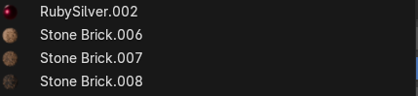
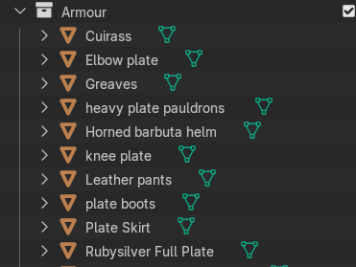
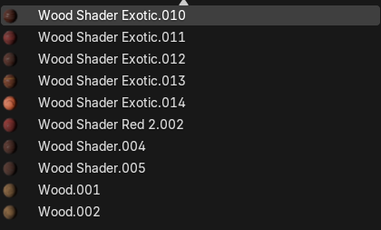
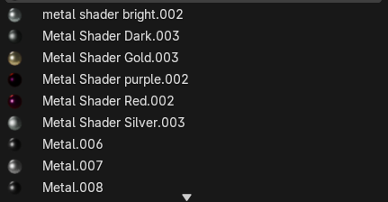
Last week
I said armour and materials

Slide 3
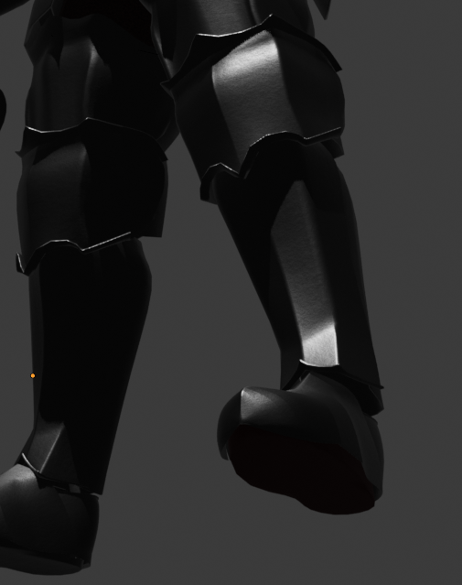
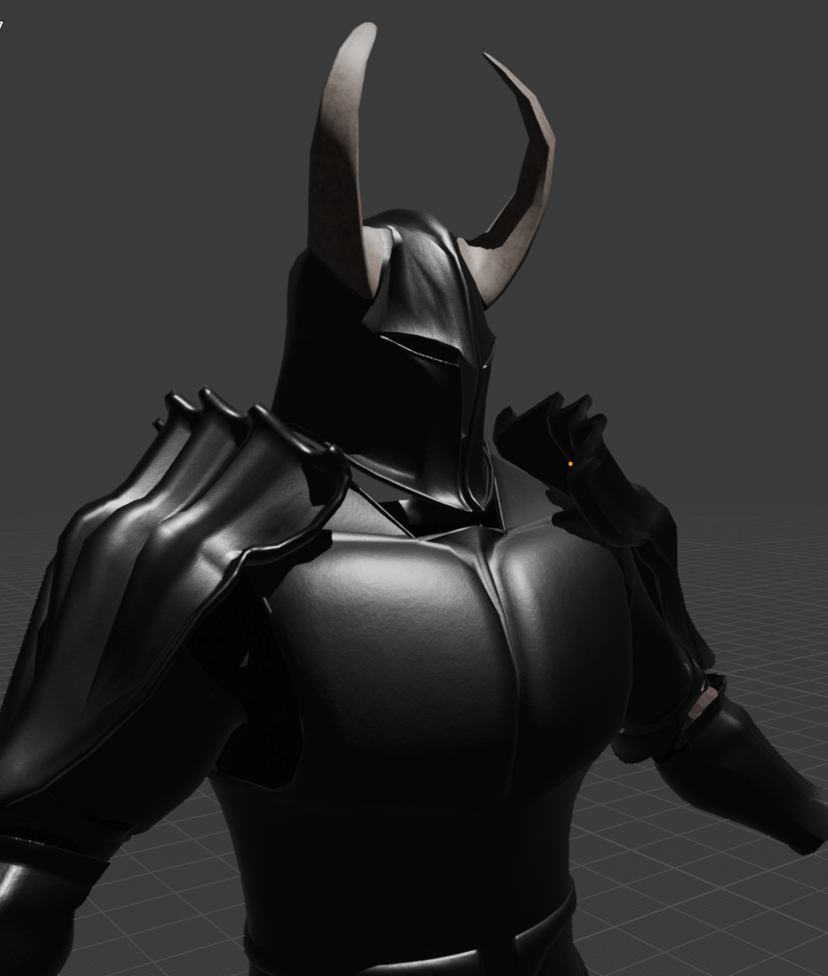
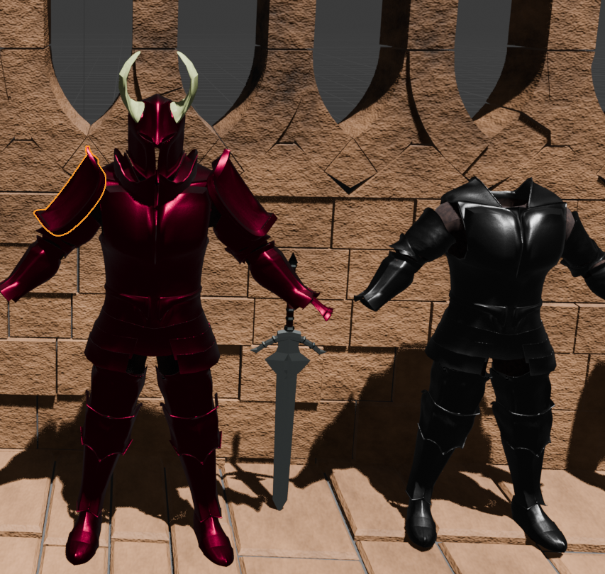
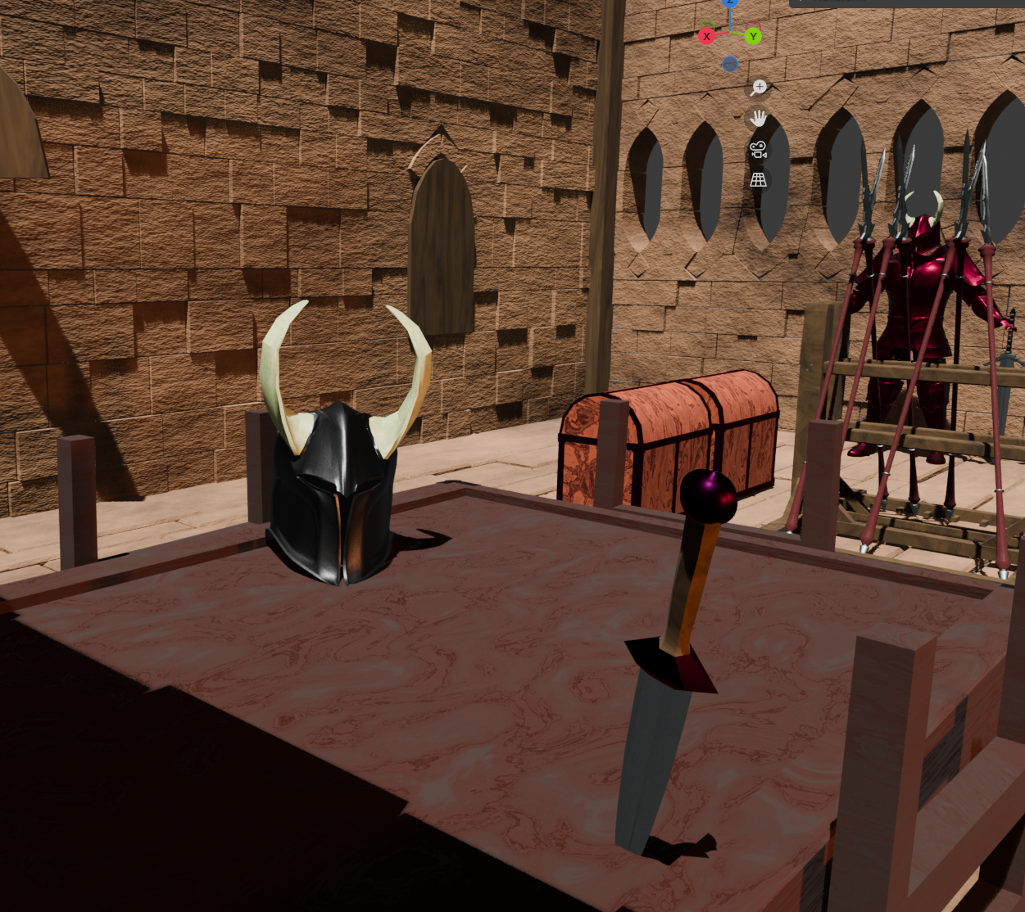
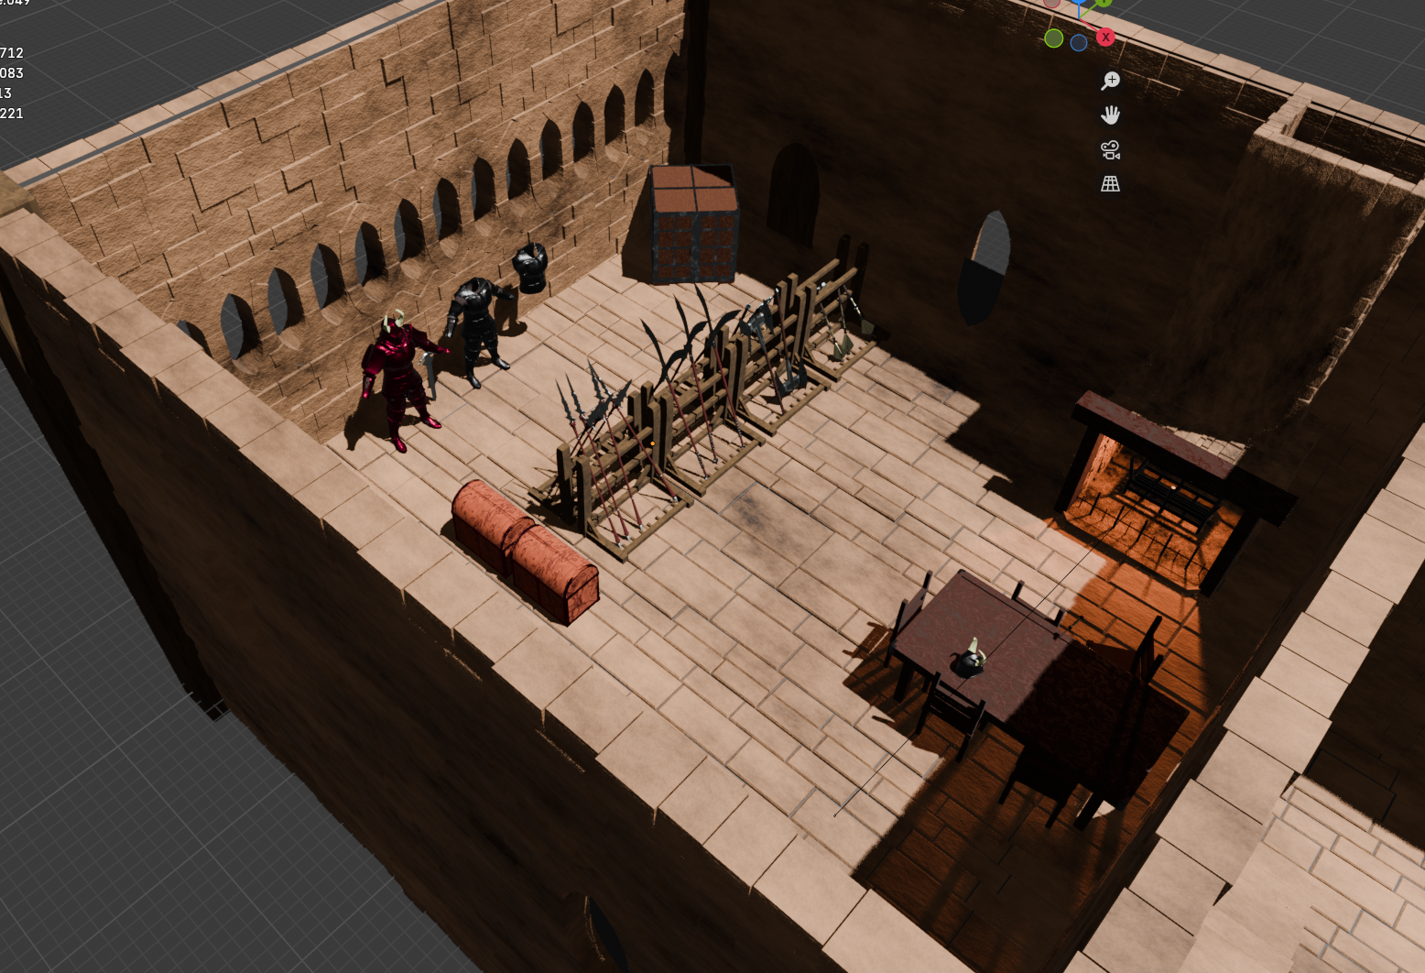
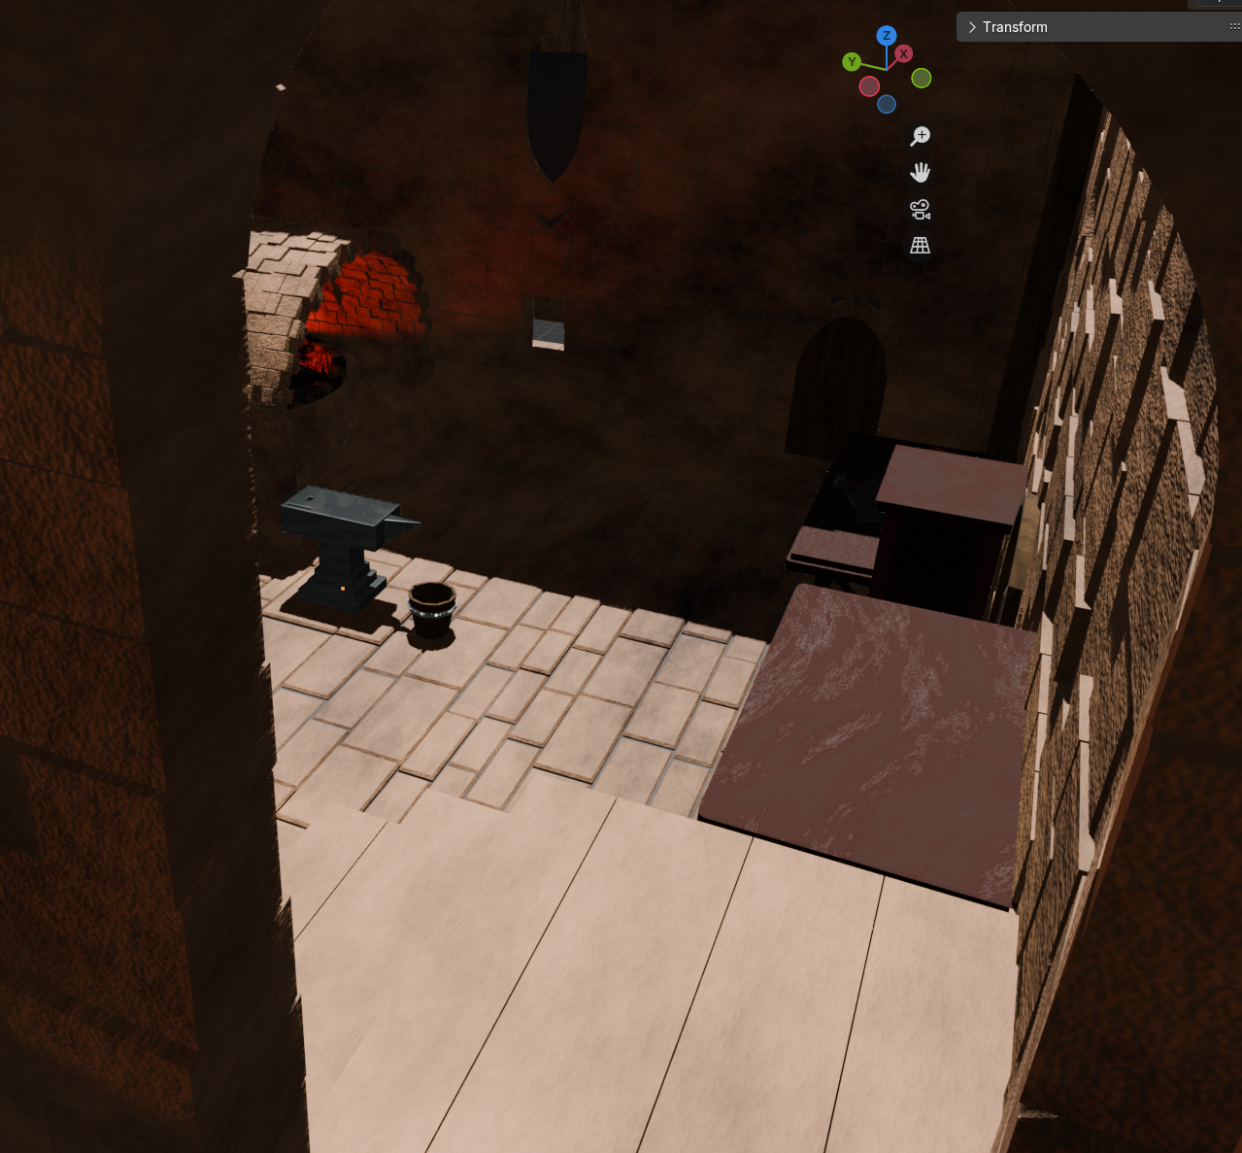
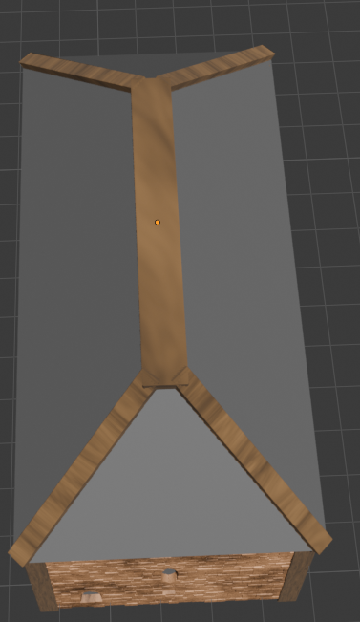
Progress check
Armour sets in development, good progress, needs more work.
Materials created and applied in good variety, needs UV unwrapping and increased detail.
Scene is created and setup, requires additional models to fill space and building needs completing.

Slide 4
This week
UVs
Retopo
Details
Building completion
More assets in scene
Lighting
Cameras

Slide 5
Feedback
Materials
Models
Building

